Slide 1
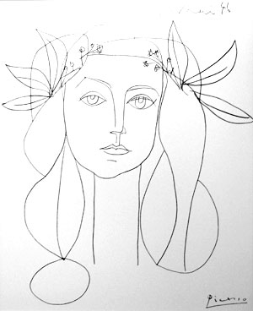
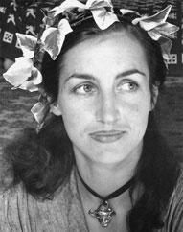
Image Features Class 2
Picasso, 1946
Francoise Gilot

Slide 2
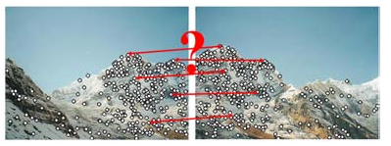
Matching Image Features
Features are used for:
Image alignment (e.g., mosaics)
3D reconstruction
Motion tracking
Object recognition
Indexing and database retrieval
Robot navigation
… others

Slide 3
Today
Harris corner detector (key point)
Match image features
Patches
Descriptors
Evaluation
Edge detector:
Sobel
Canny

Slide 4
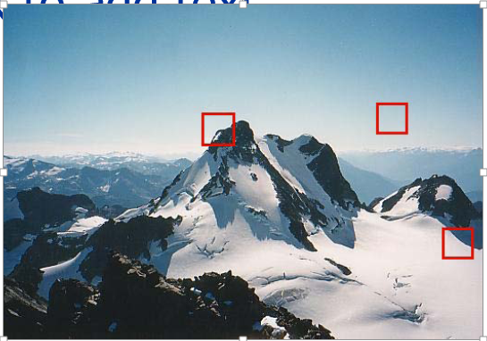
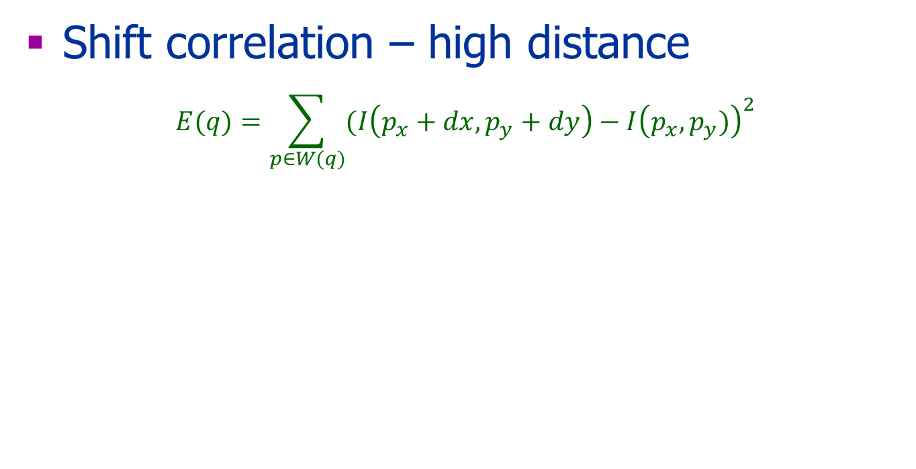
Last Class - Harris
Shift correlation – high distance
$$E(q)=\sum_{p∈W(q)}{(I\left(p_{x}+dx,p_{y}+dy\right)−I{\left(p_{x},p_{y})\right)}^{2}}$$

Slide 5

Harris Detector: Workflow

Slide 6

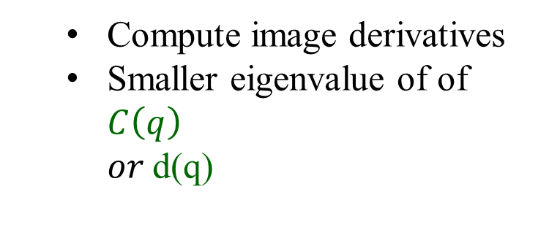
Harris Detector: Workflow
Compute corner response d
Compute image derivatives
Smaller eigenvalue of of $C\left(q\right)$ $or$d(q)

Slide 7

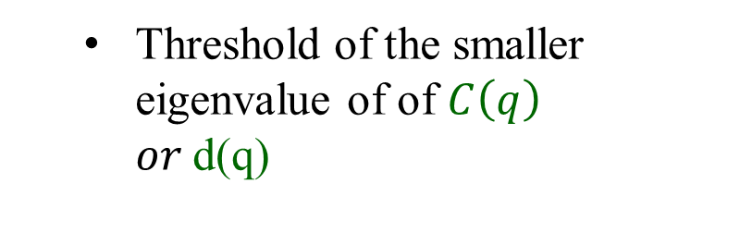
Harris Detector: Workflow
Find points with large corner response: d>threshold
Threshold of the smaller eigenvalue of of $C\left(q\right)$ $or$d(q)

Slide 8
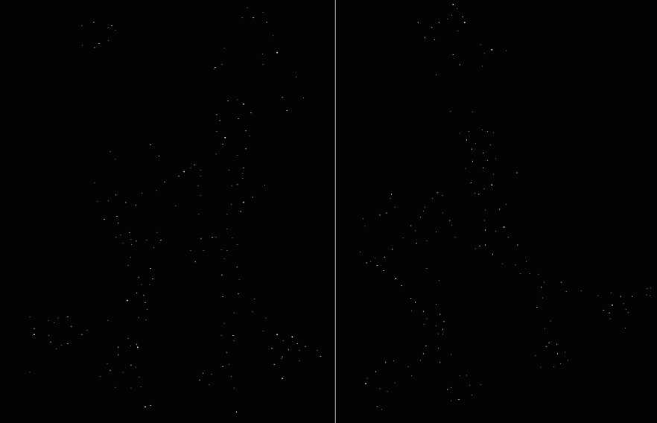
Harris Detector: Workflow
Take only the points of local maxima of d

Slide 9

Harris Detector: Workflow
Slides are borrowed from Darya Frolova, Denis Simakov

Slide 10
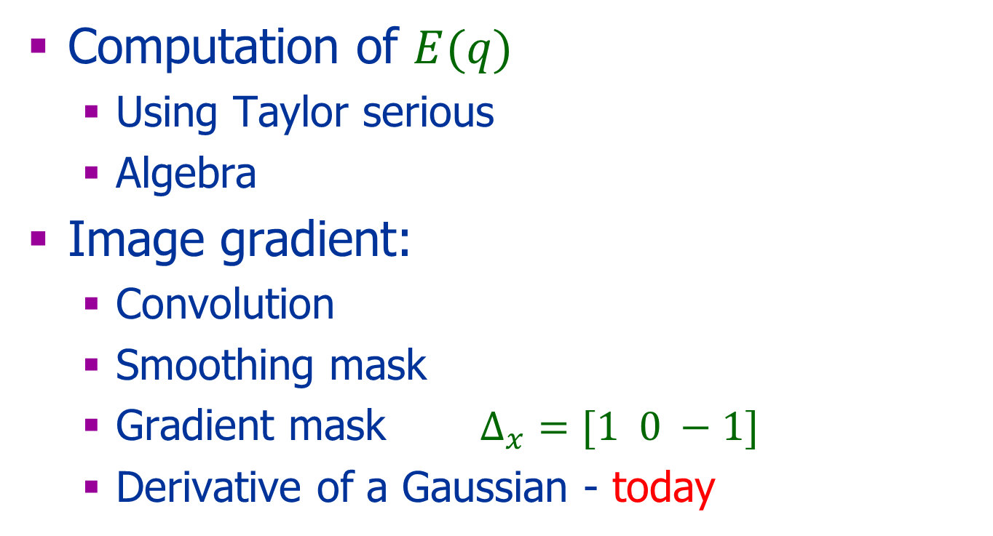
Efficiency
Computation of $E(q)$
Using Taylor serious
Algebra
Image gradient:
Convolution
Smoothing mask
Gradient mask $Δ_{x}=[1 0 −1]$
Derivative of a Gaussian - today

Slide 11
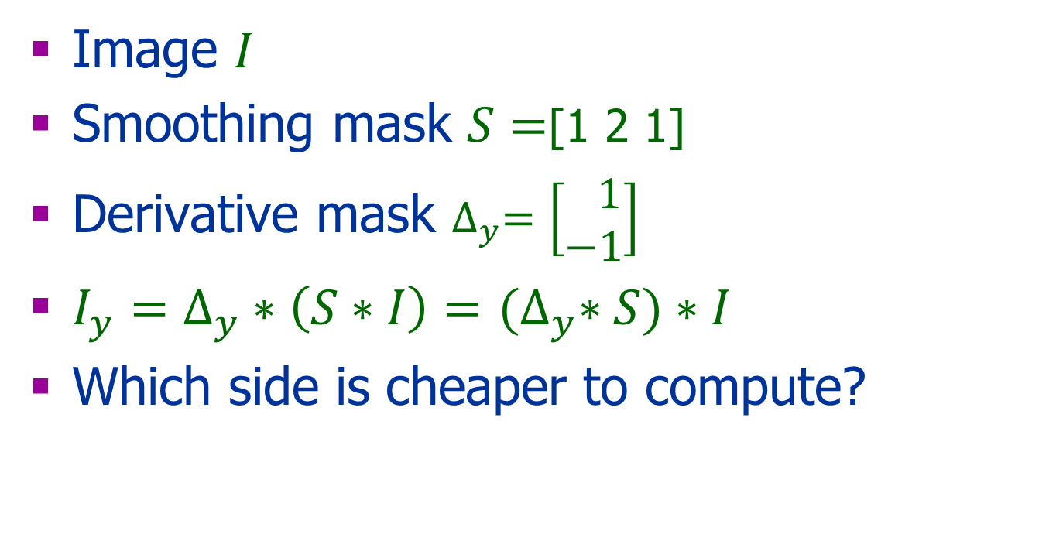
Simple Smoothing
Image $I$
Smoothing mask $S=$[1 2 1]
Derivative mask $∆_{y}=\left[\begin{aligned} 1 \\ −1\end{aligned}\right]$
$I_{y}=∆_{y}∗\left(S∗I\right)=$ ${(∆}_{y}∗S)∗I$
Which side is cheaper to compute?

Slide 12
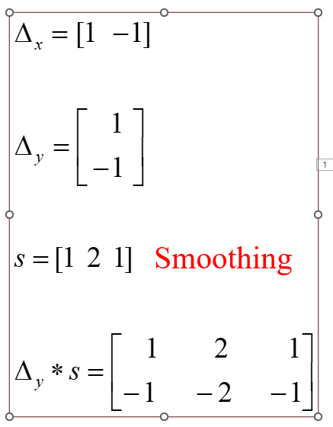
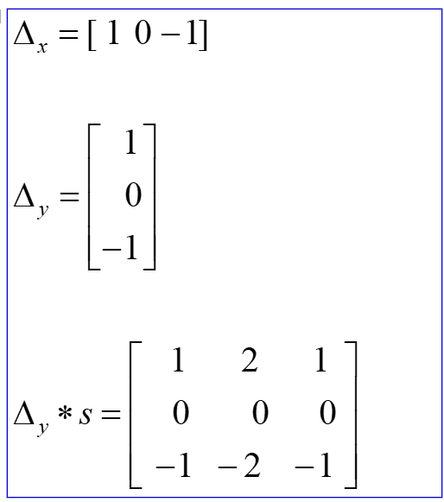
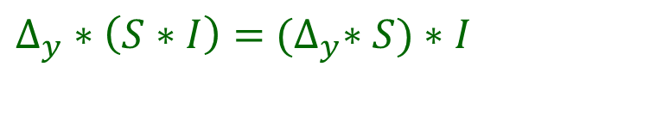
Derivative of Smoothing
$∆_{y}∗\left(S∗I\right)=$ ${(∆}_{y}∗S)∗I$
or
Smoothing
Notes:
To explain how the second derivatives are computed.
Which derivatives are computed in each of them?
I_{x} I_{y} I_{x}² (the derivative of the first derivative).

Slide 13
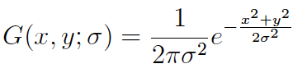
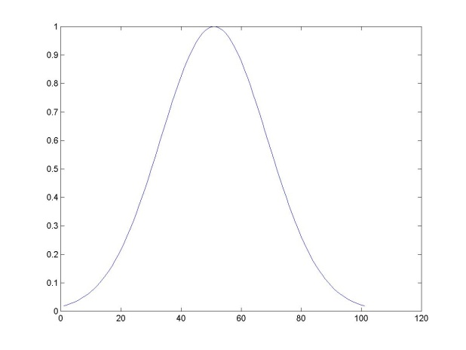
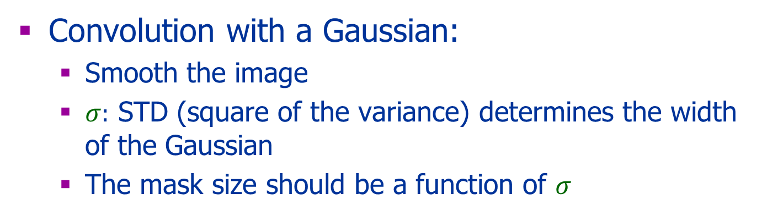
Gaussian Filter
Convolution with a Gaussian:
Smooth the image
$σ:$ STD (square of the variance) determines the width of the Gaussian
The mask size should be a function of $σ$
Notes:
Any idea why we use 1/2pi..?

Slide 14
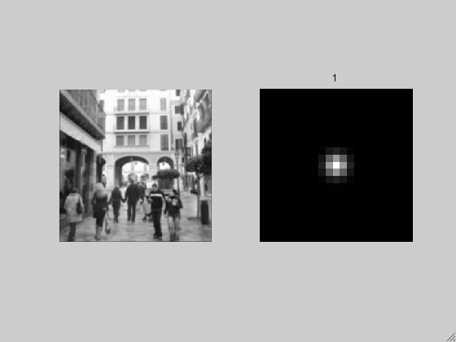
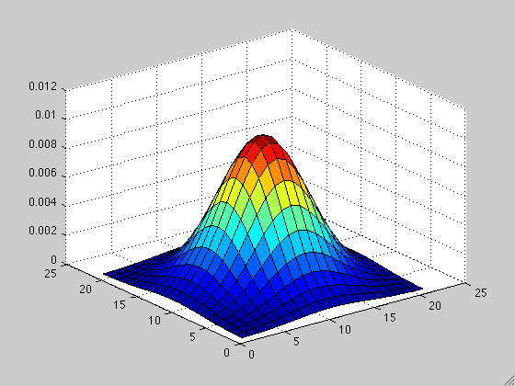
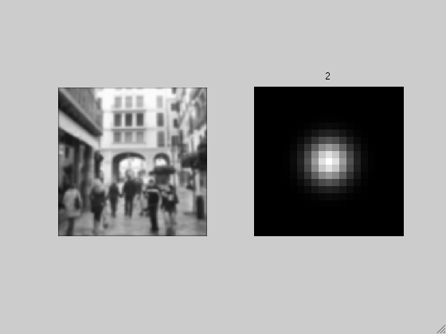
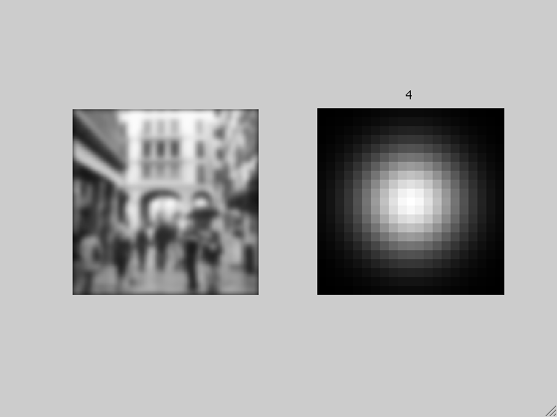
σ=1
σ=2
σ=4
Taken from Torralba

Slide 15
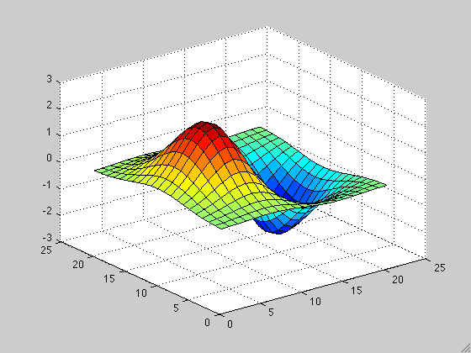
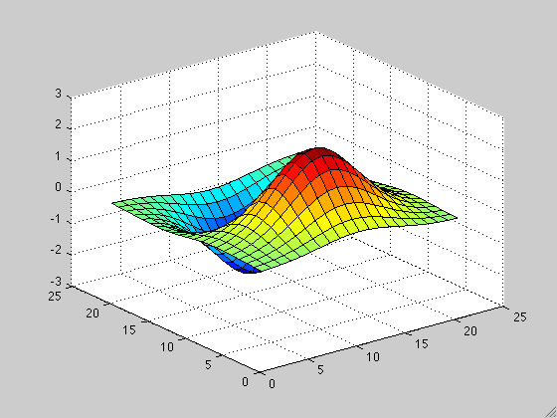
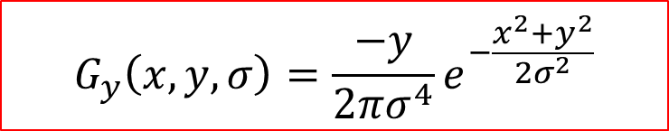
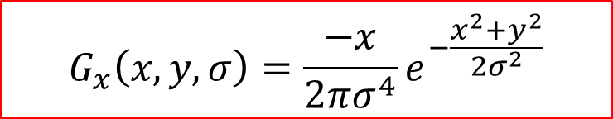
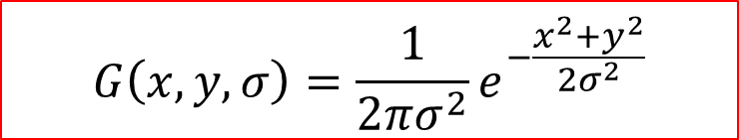
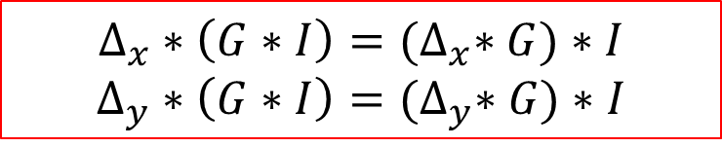

Smooth then Take Derivatives
$$Δ_{x}∗\left(G∗I\right)={(Δ}_{x}∗G)∗I$$
$$Δ_{y}∗\left(G∗I\right)={(Δ}_{y}∗G)∗I$$
$$G\left(x,y,σ\right)=\frac{1}{2πσ^{2}}e^{−\frac{x^{2}+y^{2}}{2σ^{2}}}$$
$$Δ_{x}∗\left(G∗I\right)=G_{x}∗I$$
$$Δ_{y}∗\left(G∗I\right)=G_{y}∗I$$
$$G_{x}\left(x,y,σ\right)=\frac{−x}{2πσ^{4}}e^{−\frac{x^{2}+y^{2}}{2σ^{2}}}$$
$$G_{y}\left(x,y,σ\right)=\frac{−y}{2πσ^{4}}e^{−\frac{x^{2}+y^{2}}{2σ^{2}}}$$
Associativity
Scale

Slide 16
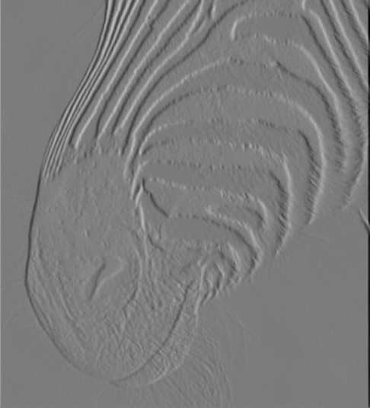
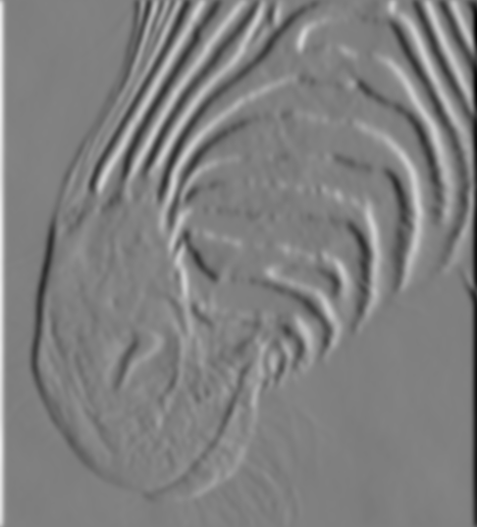
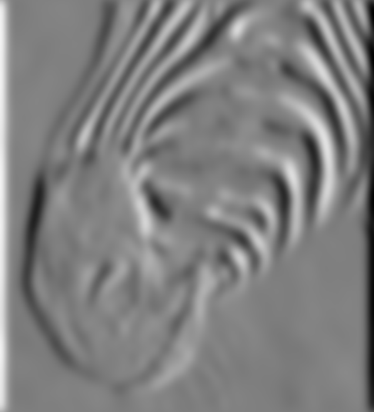
1 pixel
3 pixels
7 pixels
The scale of the smoothing filter affects derivative estimates,
Forsyth, 2002

Slide 17
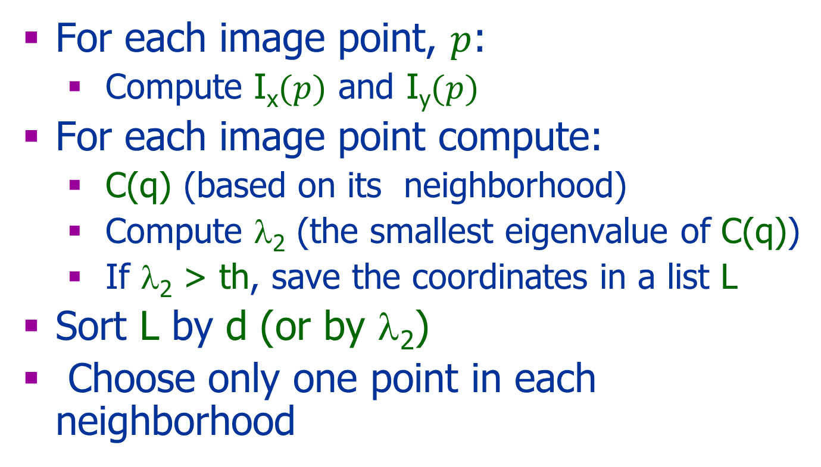
Harris Corner Detector Algorithm
For each image point, $p$:
Compute I_{x}$(p)$ and I_{y}$(p)$
For each image point compute:
C(q) (based on its neighborhood)
Compute λ₂ (the smallest eigenvalue of C(q))
If λ₂ > th, save the coordinates in a list L
Sort L by d (or by λ₂)
Choose only one point in each neighborhood
Compute d(q)= λ₁ λ₂-k(λ1+ λ2)= det(C)-k*Trace(C)²
d(q)

Slide 18
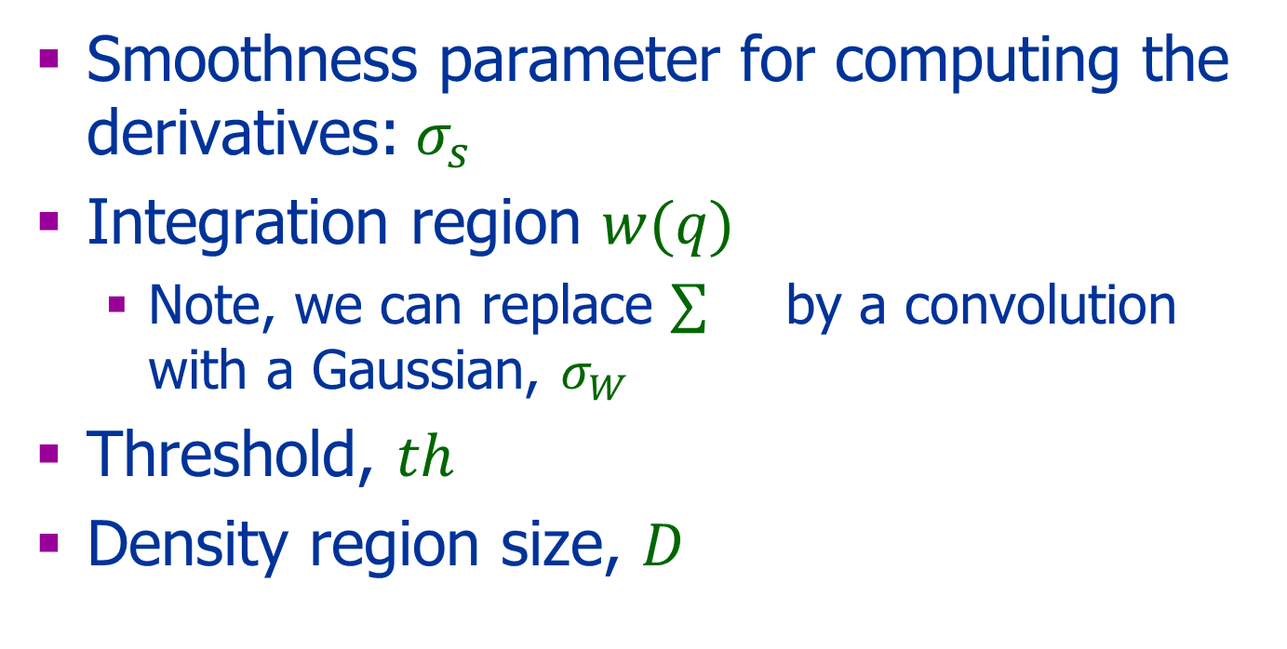
The Parameters
Smoothness parameter for computing the derivatives:$σ_{s}$
Integration region $w(q)$
Note, we can replace by a convolution with a Gaussian, $σ_{W}$
Threshold, $th$
Density region size, $D$

Slide 19
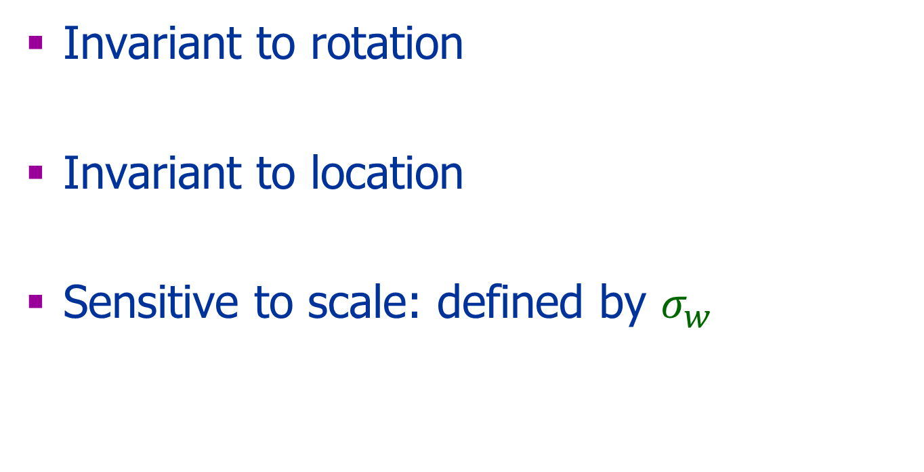
Properties
Invariant to rotation
Invariant to location
Sensitive to scale: defined by $σ_{w}$

Slide 20
Match Image Features
Find interest point
Descriptors:
Location in the image
A patch around the point
Other descriptors of the patch
Match by:
Nearest neighbor (e.g., from im1 to im2)
Other options
what is the size and orientation?

Slide 21
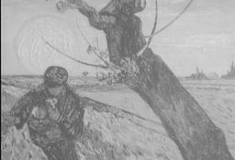
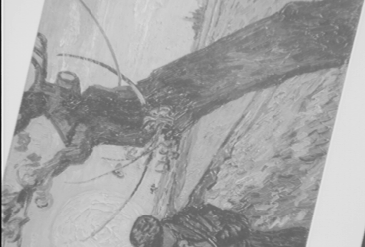
Matching Descriptors
Similarity of descriptors
Semi-local constraints
Global constraints:
Fundamental matrix
Affine transformation
Later on in the course
( )
?
( )
=
Vector comparison

Slide 22
Descriptor - Desired Properties
Discriminative
Efficient to compute
Robust to image variations

Slide 23
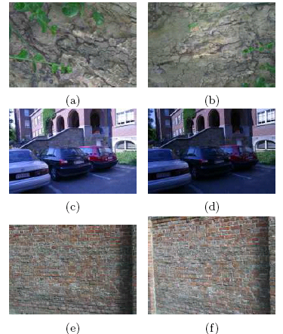
Image Variations Examples
Viewpoint change (graf)
Scale + Rotation (bark)
Blur
Blurring (bikes)
Illumination change (leuven)

Slide 24
Simple Patch Descriptor
Expected problems:
Scale
Orientation
Illumination
Let’s look for a better one

Slide 25
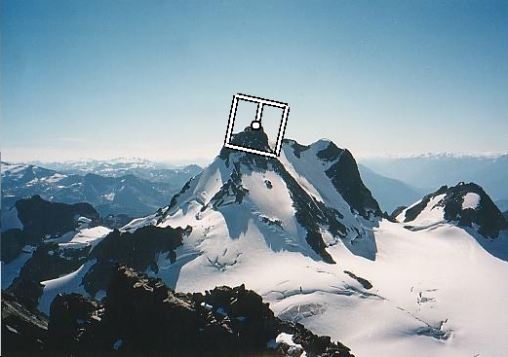
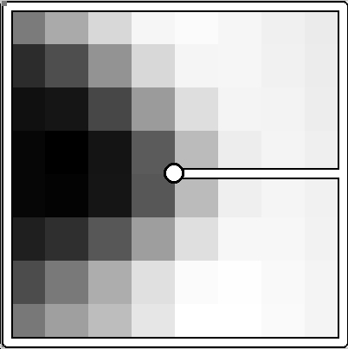
Match Harris Patch
Detection:
Invariant to translation & rotation
Patch normalization:
Orientation: use corner direction (defined by the eignevectors)
Scale: use detected scale
Intensity normalization
How?

Slide 26
Scale
Consider regions (e.g. circles) of different sizes around a point
Regions of corresponding correct sizes will look the same in both images
If the right orientation is used
What is the right scale?
Computer Vision by Y. Moses

Slide 27
Detections at Multiple Scales

Slide 28
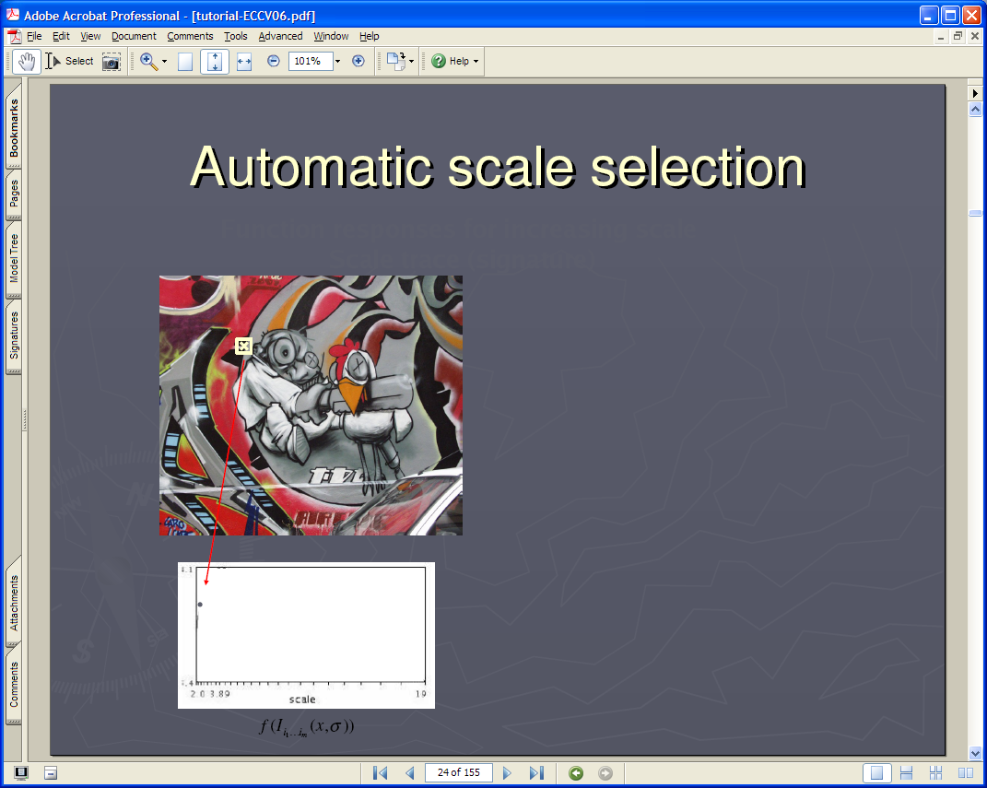
Lindeberg et al, 1996
Lindeberg et al., 1996
Slide from Tinne Tuytelaars
Slide from Tinne Tuytelaars

Slide 29

Slide from Tinne Tuytelaars

Slide 30

Slide from Tinne Tuytelaars

Slide 31

Slide from Tinne Tuytelaars

Slide 32
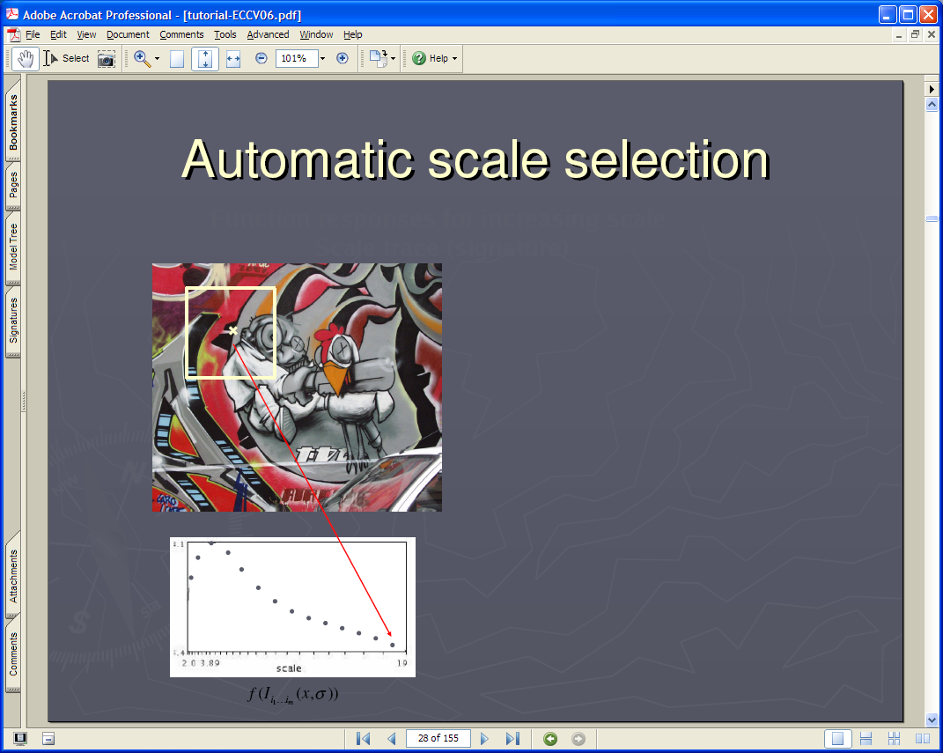
Slide from Tinne Tuytelaars

Slide 33

Slide from Tinne Tuytelaars

Slide 34
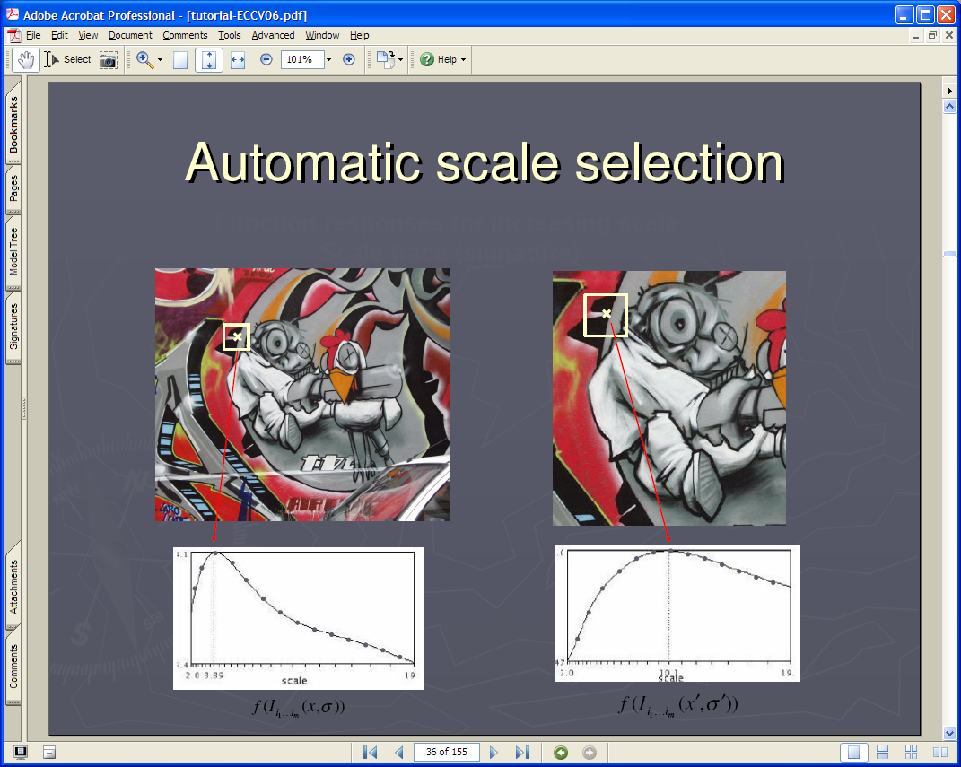
Slide from Tinne Tuytelaars

Slide 35
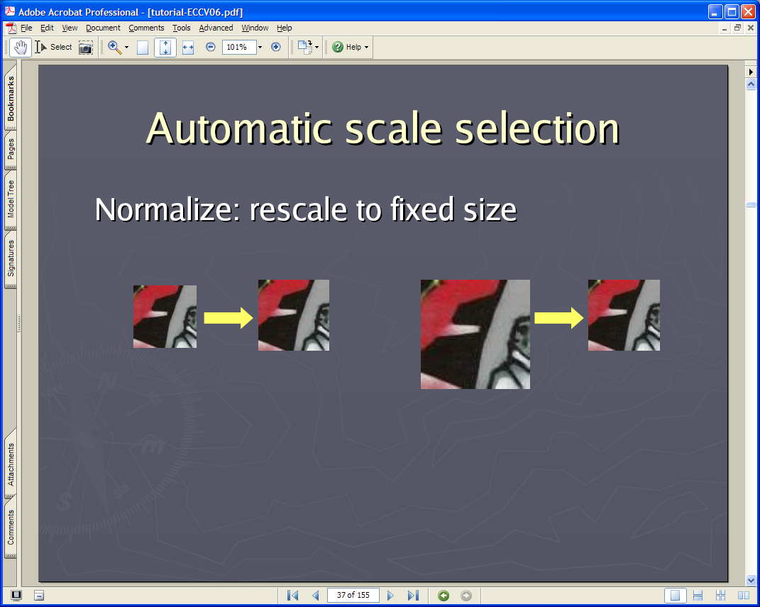
Slide from Tinne Tuytelaars

Slide 36
Slide from Tinne Tuytelaars

Slide 37
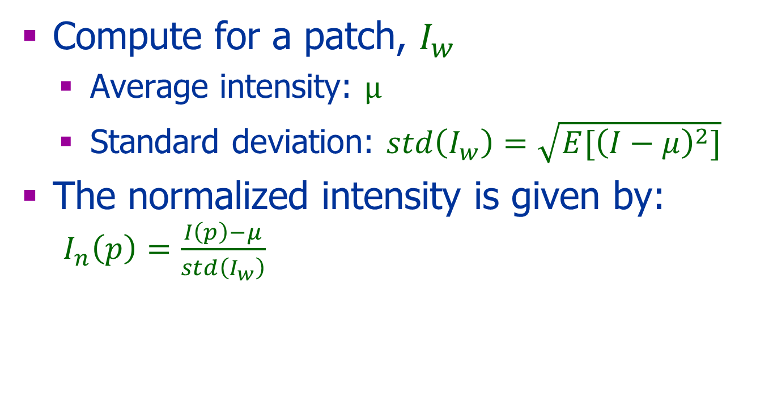
Intensity Normalization
Compute for a patch, $I_{w}$
Average intensity: $μ$
Standard deviation: $std\left(I_{w}\right)=\sqrt{E{[\left(I−μ\right)}^{2}]}$
The normalized intensity is given by: $I_{n}\left(p\right)=\frac{I\left(p\right)−μ}{std\left(I_{w}\right)}$

Slide 38
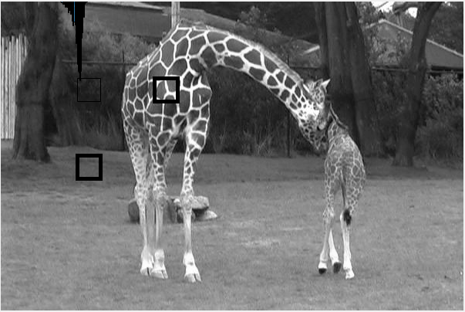
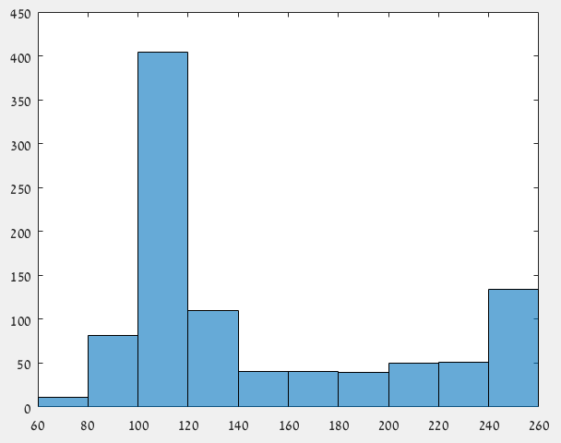
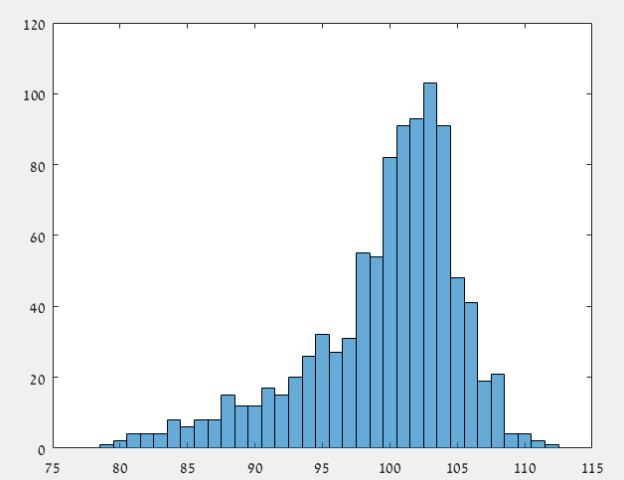
Other Descriptors
To overcome intensity change:
Intensity normalization
Take the derivative of the patch
To overcome small misalignments:
Use histogram of the patch
Distance between histograms!

Slide 39
SIFT - Feature
Scale Invariant Feature Transform
Interest point and descriptor
The interest point: defined in a different manner than Harris corner
(We do not go over it in the course)
The descriptor: next

Slide 40

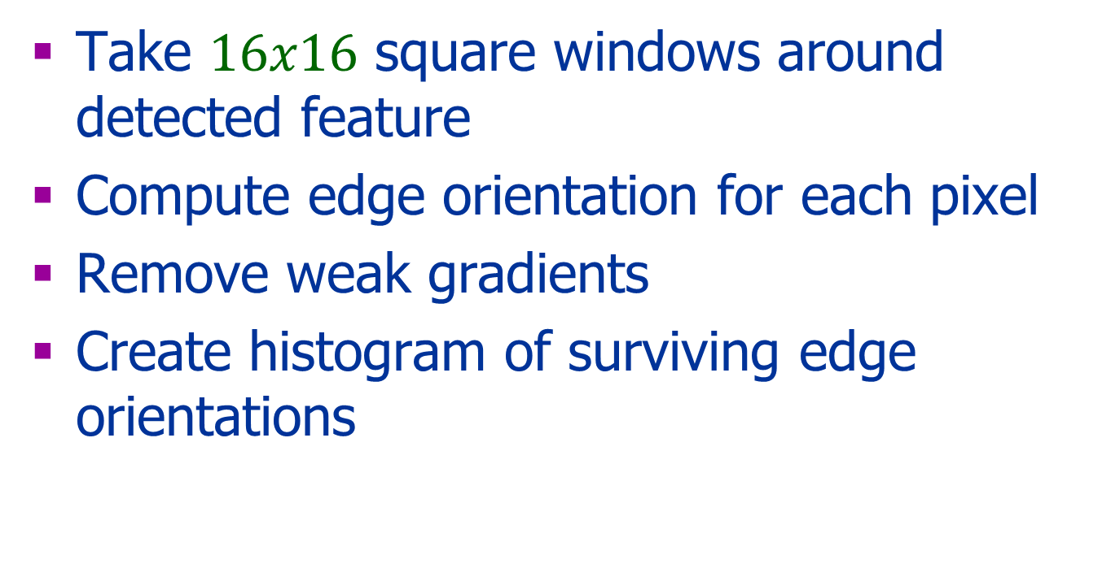
SIFT Descriptor
Take $16x16$ square windows around detected feature
Compute edge orientation for each pixel
Remove weak gradients
Create histogram of surviving edge orientations

Slide 41
SIFT Descriptor
16 cells * 8 orientations = 128 dimensional descriptor
0
2π
angle histogram
Adapted from slide by David Lowe

Slide 42
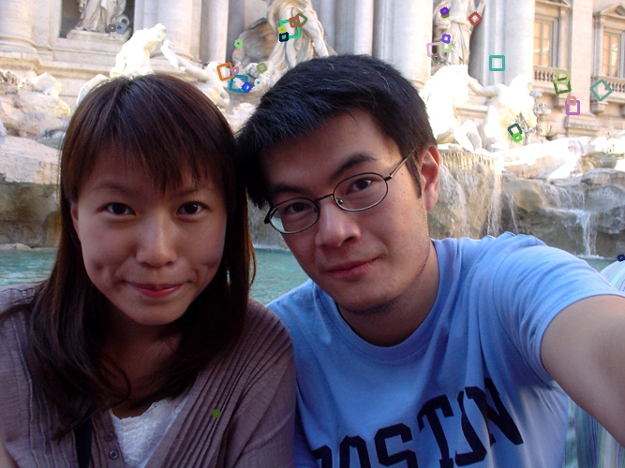
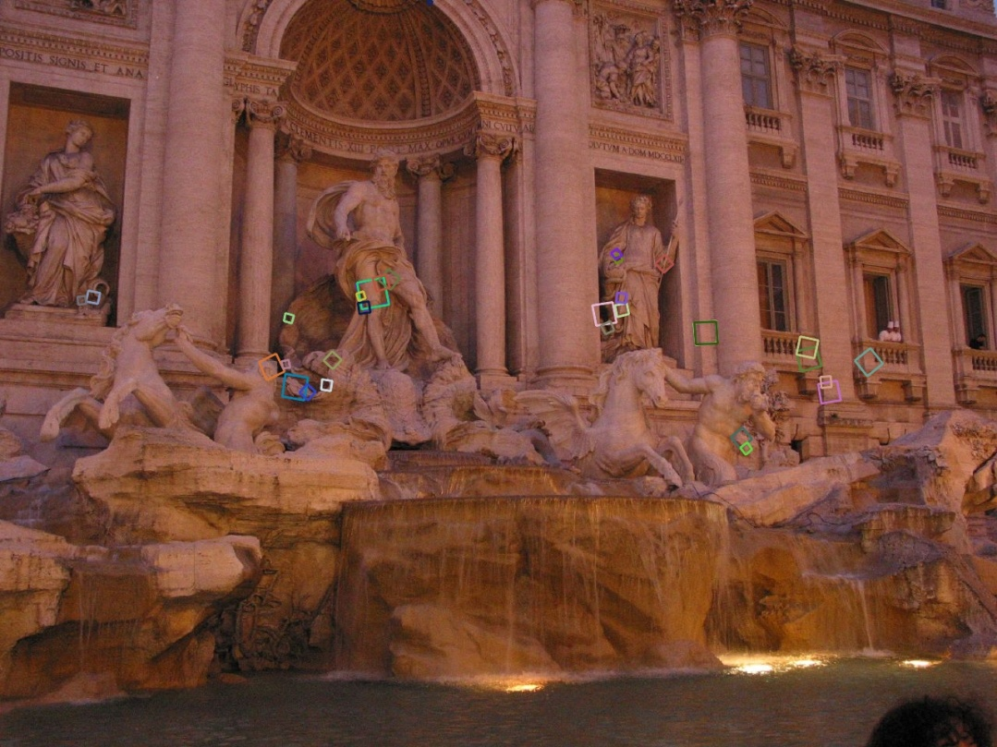
Properties of SIFT
Changes in viewpoint:
Up to about 60 degree out of plane rotation
Significant changes in illumination
Fast and efficient (not anymore …)
Adapted from Steve Seitz

Slide 43
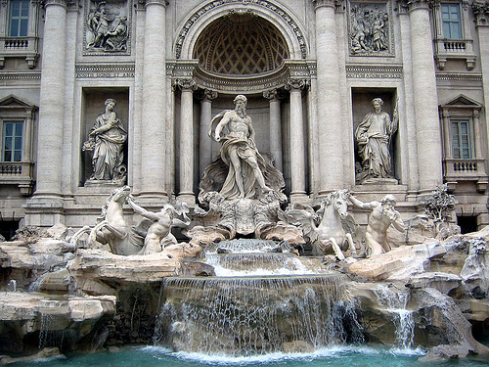
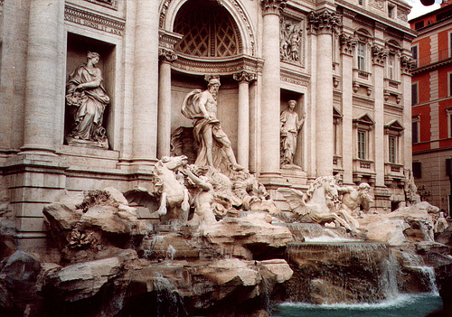
Eliminating Bad Matches
Throw out features with distance > th
What is the right threshold?
50
true match
75
200
false match
feature distance
Adapted from Steve Seitz

Slide 44

Feature Matching
Nearest Neighbor:
Sum of square differences (SSD), and threshold
Problem: ambiguous matching
f₁
f₂
Adapted from Seitz (also next slide)

Slide 45
Feature Matching
Distance Ratio
f₂ and f₂’ best and 2nd best matches to f₁
Search for low d(f₁, f₂) / d(f₁, f₂’)
Large values (~1) for ambiguous matches
f₂
f₂'
f₁

Slide 46


Use Geometry
Later in the course
Robust estimation of the fundamental matrix
99 inliers
89 outliers

Slide 47
Performance Evaluation
Compare parameters
Compare different methods

Slide 48
True/false positives
The distance threshold affects performance
True positives = # of detected matches that are correct
To maximize: how to choose threshold?
False positives = # of detected matches that are incorrect
To minimize: how to choose threshold?
true match
200
false match
Adapted from Steve Seitz

Slide 49
Evaluation
True Positive (TP): Correct detection
True Negative (TN): Correct no-detection
False positive (FP): Incorrect detection
False negative (FN): Incorrect no-detection

Slide 50


Evaluation
Recall = $\frac{TP}{TP+FN}$
Precision = $\frac{TP}{TP+FP}$

Slide 51


More on feature detection/description

Slide 52





Performance Evaluation
Scale + Rotation (bark)
Viewpoint change (wall)
Viewpoint change (graf)
Blurring (bikes)
Illumination change (leuven)

Slide 53
Summary Descriptors
Patch / normalized patch
Local histogram
Local SIFT descriptor (one of the most popular classic one)
Many more : see list in Szeliski book and latest conferences
Use deep learning – beyond our scope – see references

Slide 54
Homework
Moodle submission
Pairs or single – one submission for a pair and a text for the other
Piazza questions
Efficient vectorized code
Honor code

Slide 55
Bibliography
A COMBINED CORNER AND EDGE DETECTOR, Harris & Stephens, Alvey Vision Conference, 1988
Object Recognition from Local Scale-Invariant Features (1999) - SIFT

Slide 56
Bibliography
Example of NN based methods:
A review of multimodal image matching: Methods and applications
Image matching from handcrafted to deep features: A survey
And many more!

Slide 57
Next Class
Edge detection
Geometry

